Slide 1
CluedIn Fundamentals: Edit mode and validations
Fixing invalid values in properties used for generating primary and additional identifiers directly in the data set

Slide 2
Using edit mode to fix invalid values directly in the data set
Using validations to find invalid values in the data set
Training agenda
Demo of edit mode and validations

Slide 3


Previously, we explored how CluedIn handles empty values in identifier properties—using hash codes for primary identifiers and ignoring them for additional identifiers.
How to generate meaningful identifiers?
How to fix invalid values in identifier properties to generate more meaningful primary and additional identifiers?

Slide 4
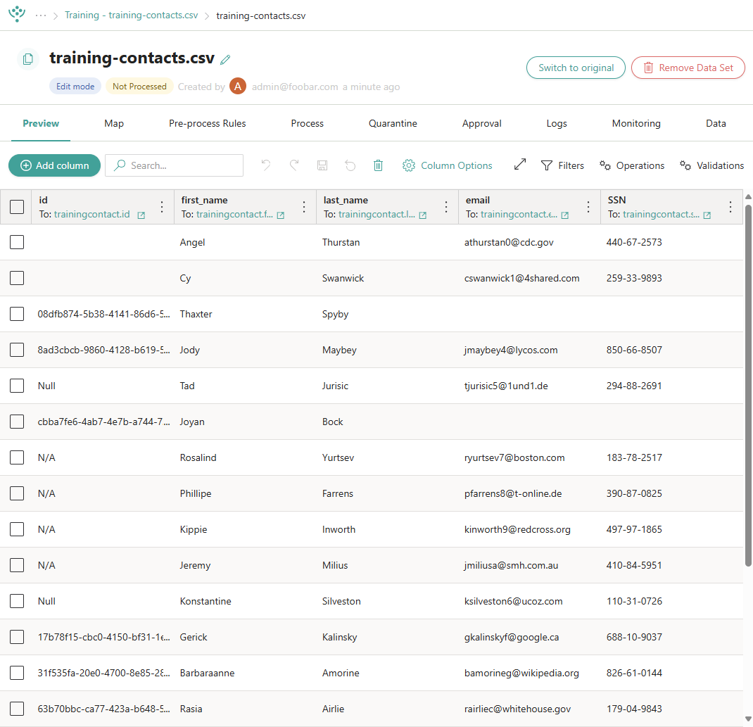
Edit mode allows you to perform operations and validations on source records to identify and fix issues before processing.
When you switch to edit mode, CluedIn creates a clone of the original data set, so you can revert to it at any time.
What is edit mode?

Slide 5
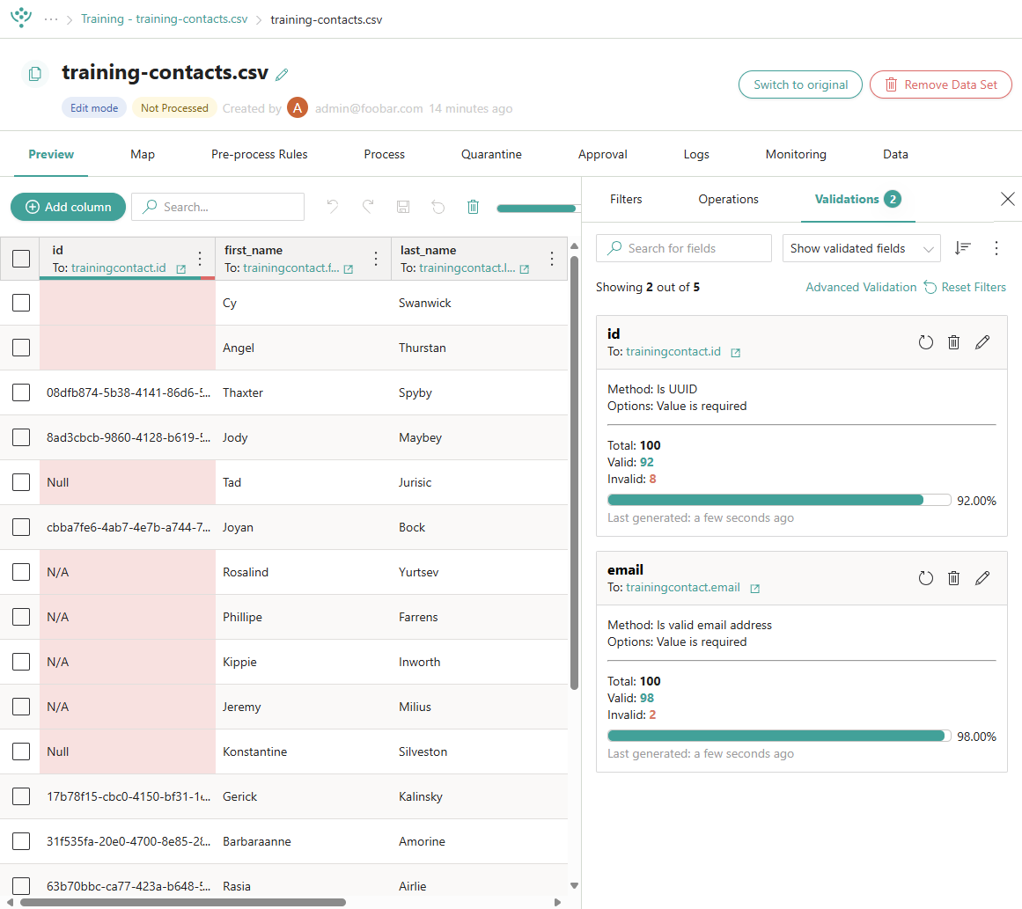

What is the purpose of validations?
When your data set is in edit mode, you can use validations to check source records for errors, inconsistencies, and missing values.
Validations help you quickly identify invalid values so you can fix them and improve the overall quality of your data before processing.

Slide 6
DEMO: Using edit mode and validations to fix invalid values in identifier properties

Slide 7
Demo summary
You’ve seen how to:
Switch the data set to edit mode
Add validations and find invalid values in the data set
Fix invalid values directly in the data set
Outcome:
You now understand how to use edit mode and validations to fix invalid values directly in the data set before processing.
Important:
You do not need to replicate this process yourself, as the training files from the previous sessions are not suitable. This demonstration is intended to illustrate the concept.

Slide 8
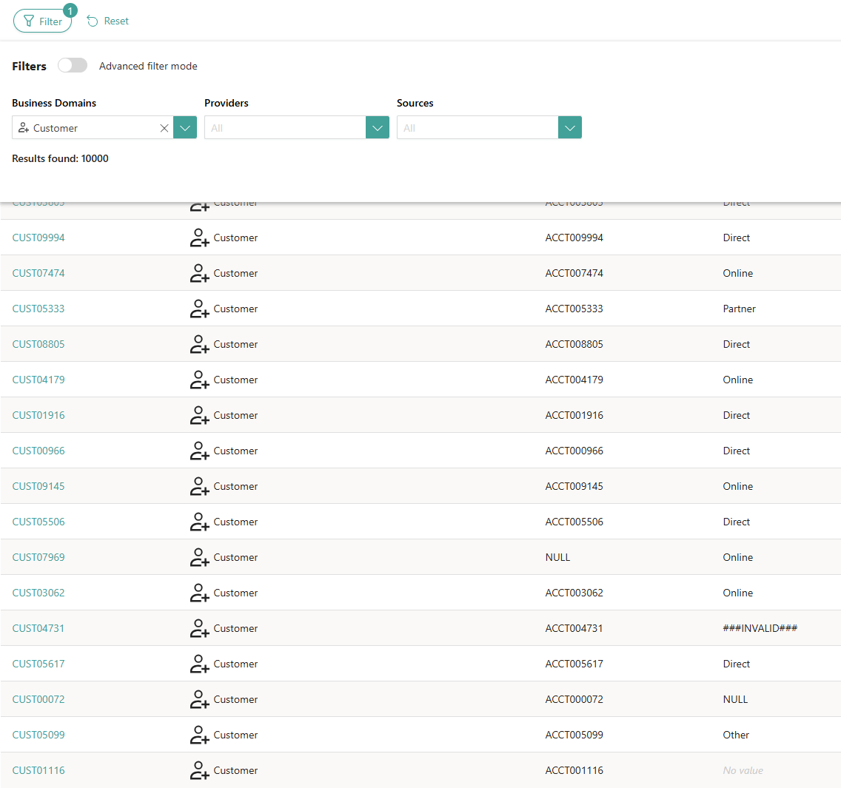


Learn more about edit mode and validations in our documentation portal.
Next session: Tagging golden records that contain invalid values
What’s next?

